Slide 1
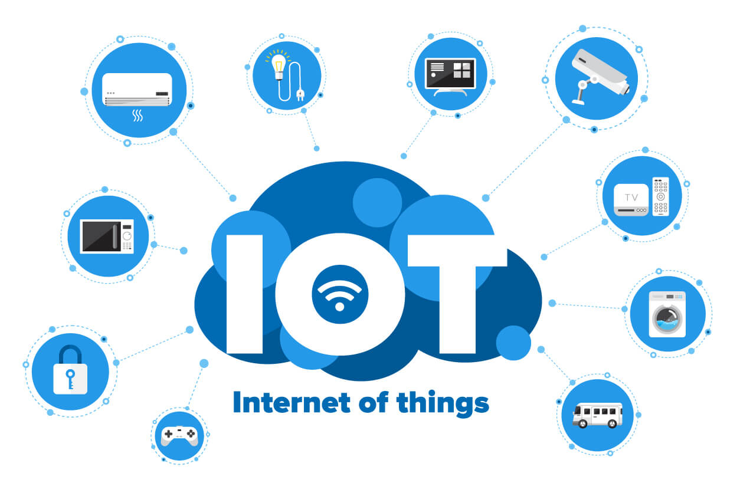
Internet of things
By mazen elbeik

Slide 2
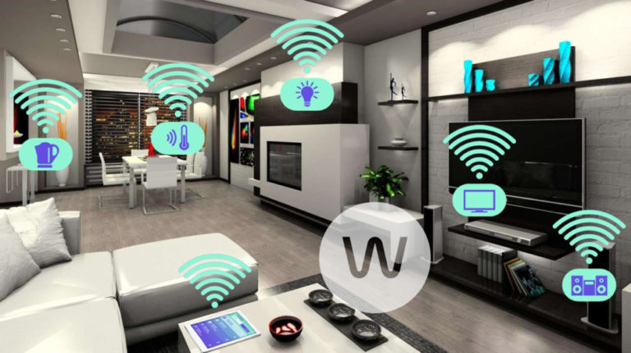

Introduction
Preamble
What is IoT
Why IoT
Overview

Slide 3
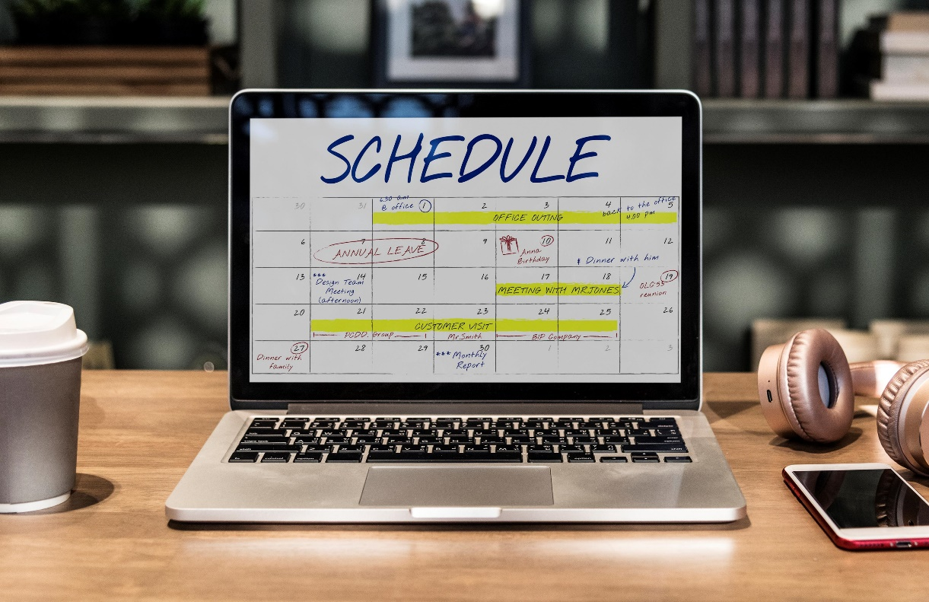
The Agenda
Microcontrollers
Building circuits
Multi-platform dev
Linking devices
Design
Conclusion

Slide 4
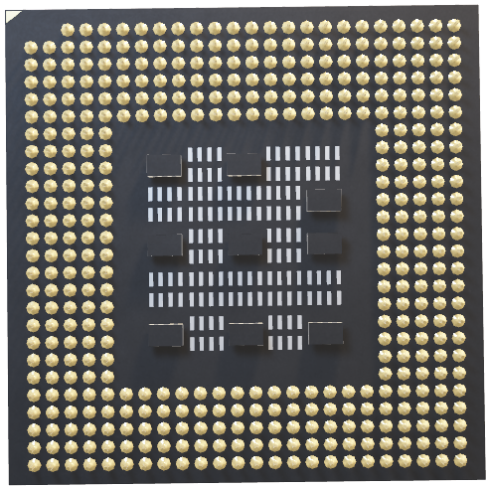
Microcontrollers

Slide 5
Microntrollers
Definition
Arduino & Esp ecosystem

Slide 6
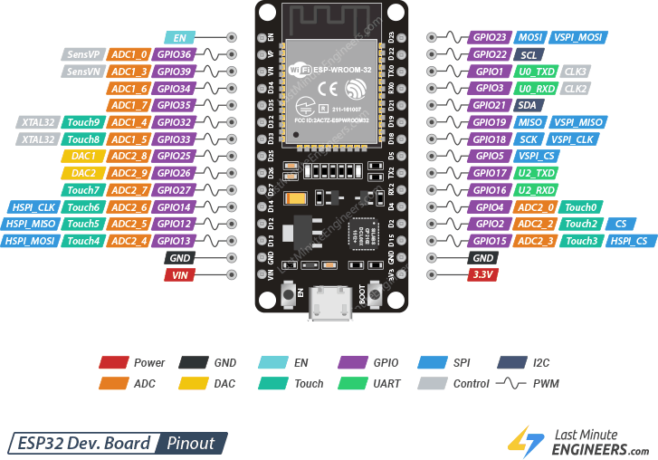
Microntrollers
Definition
Arduino & Esp ecosystem

Slide 7
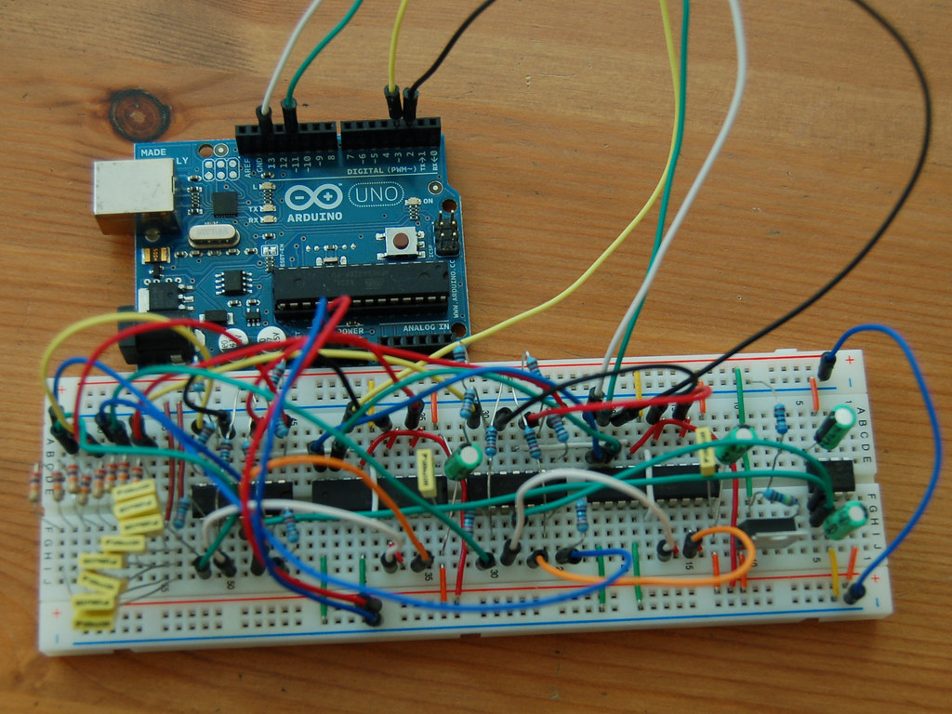
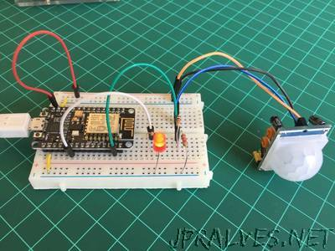
Building circuits
Bread board
Pcb

Slide 8
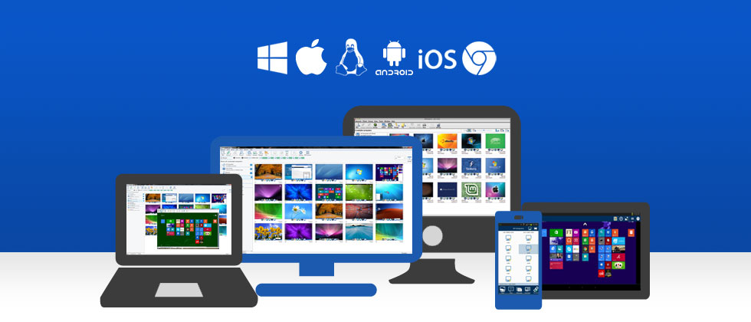
Multi-platform development

Slide 9


Slide 10
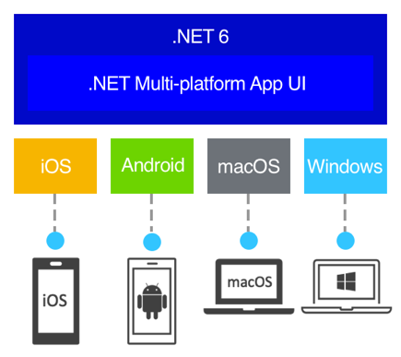

Slide 11
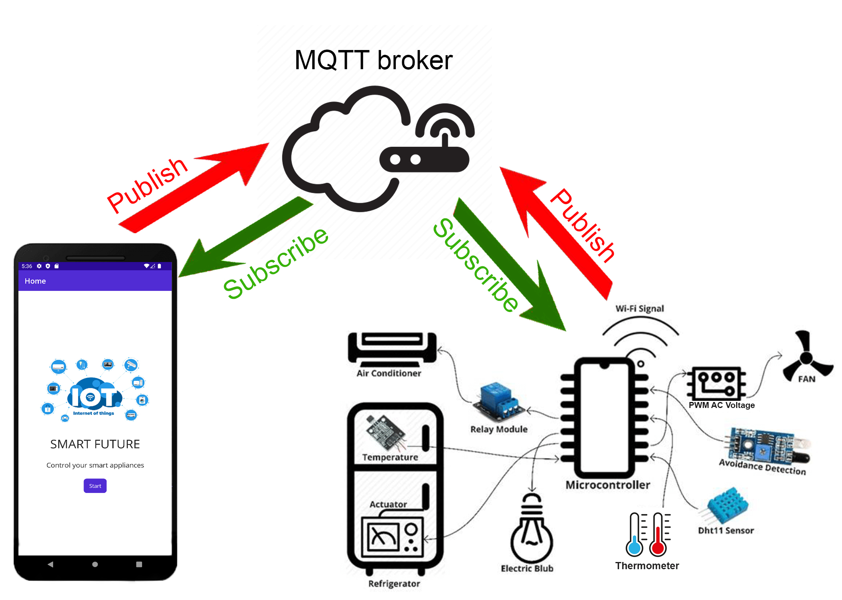
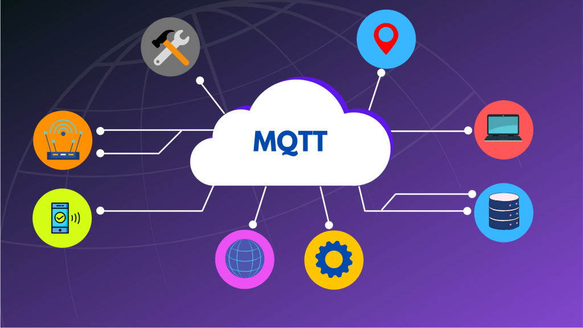
Linking DEVICES

Slide 12
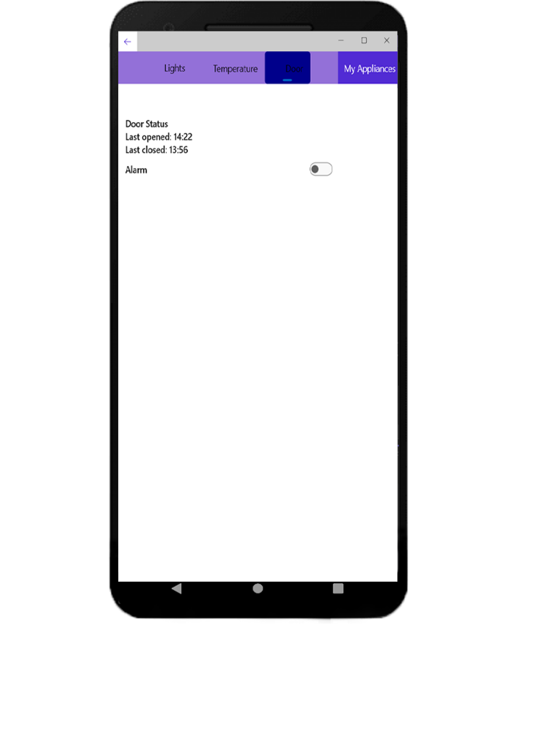
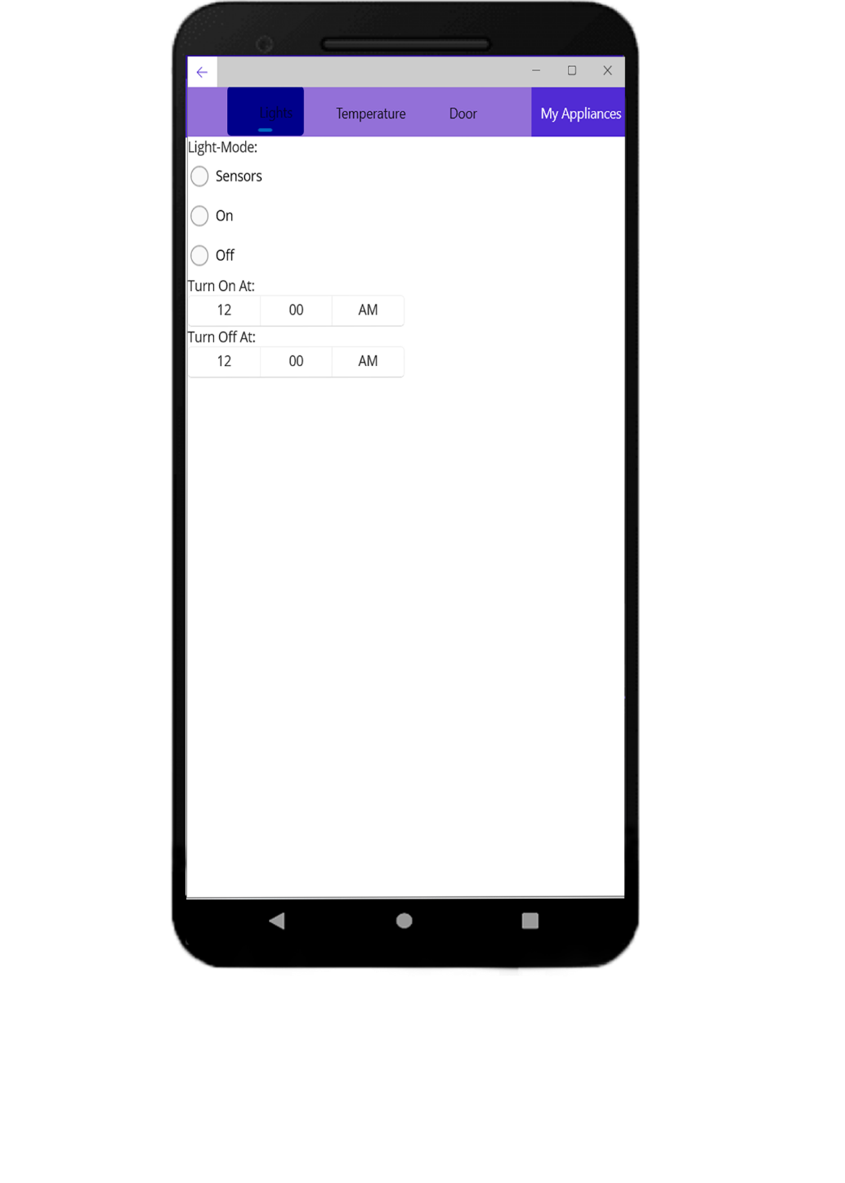
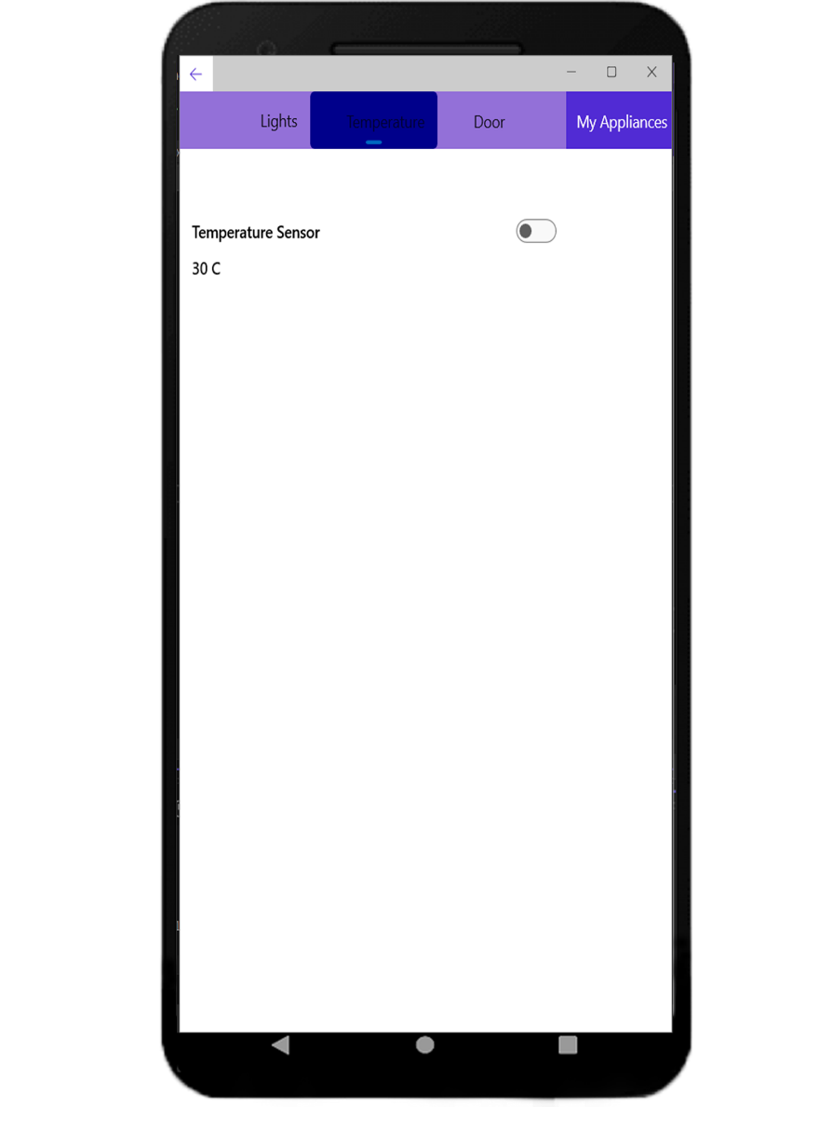
Design

Slide 13
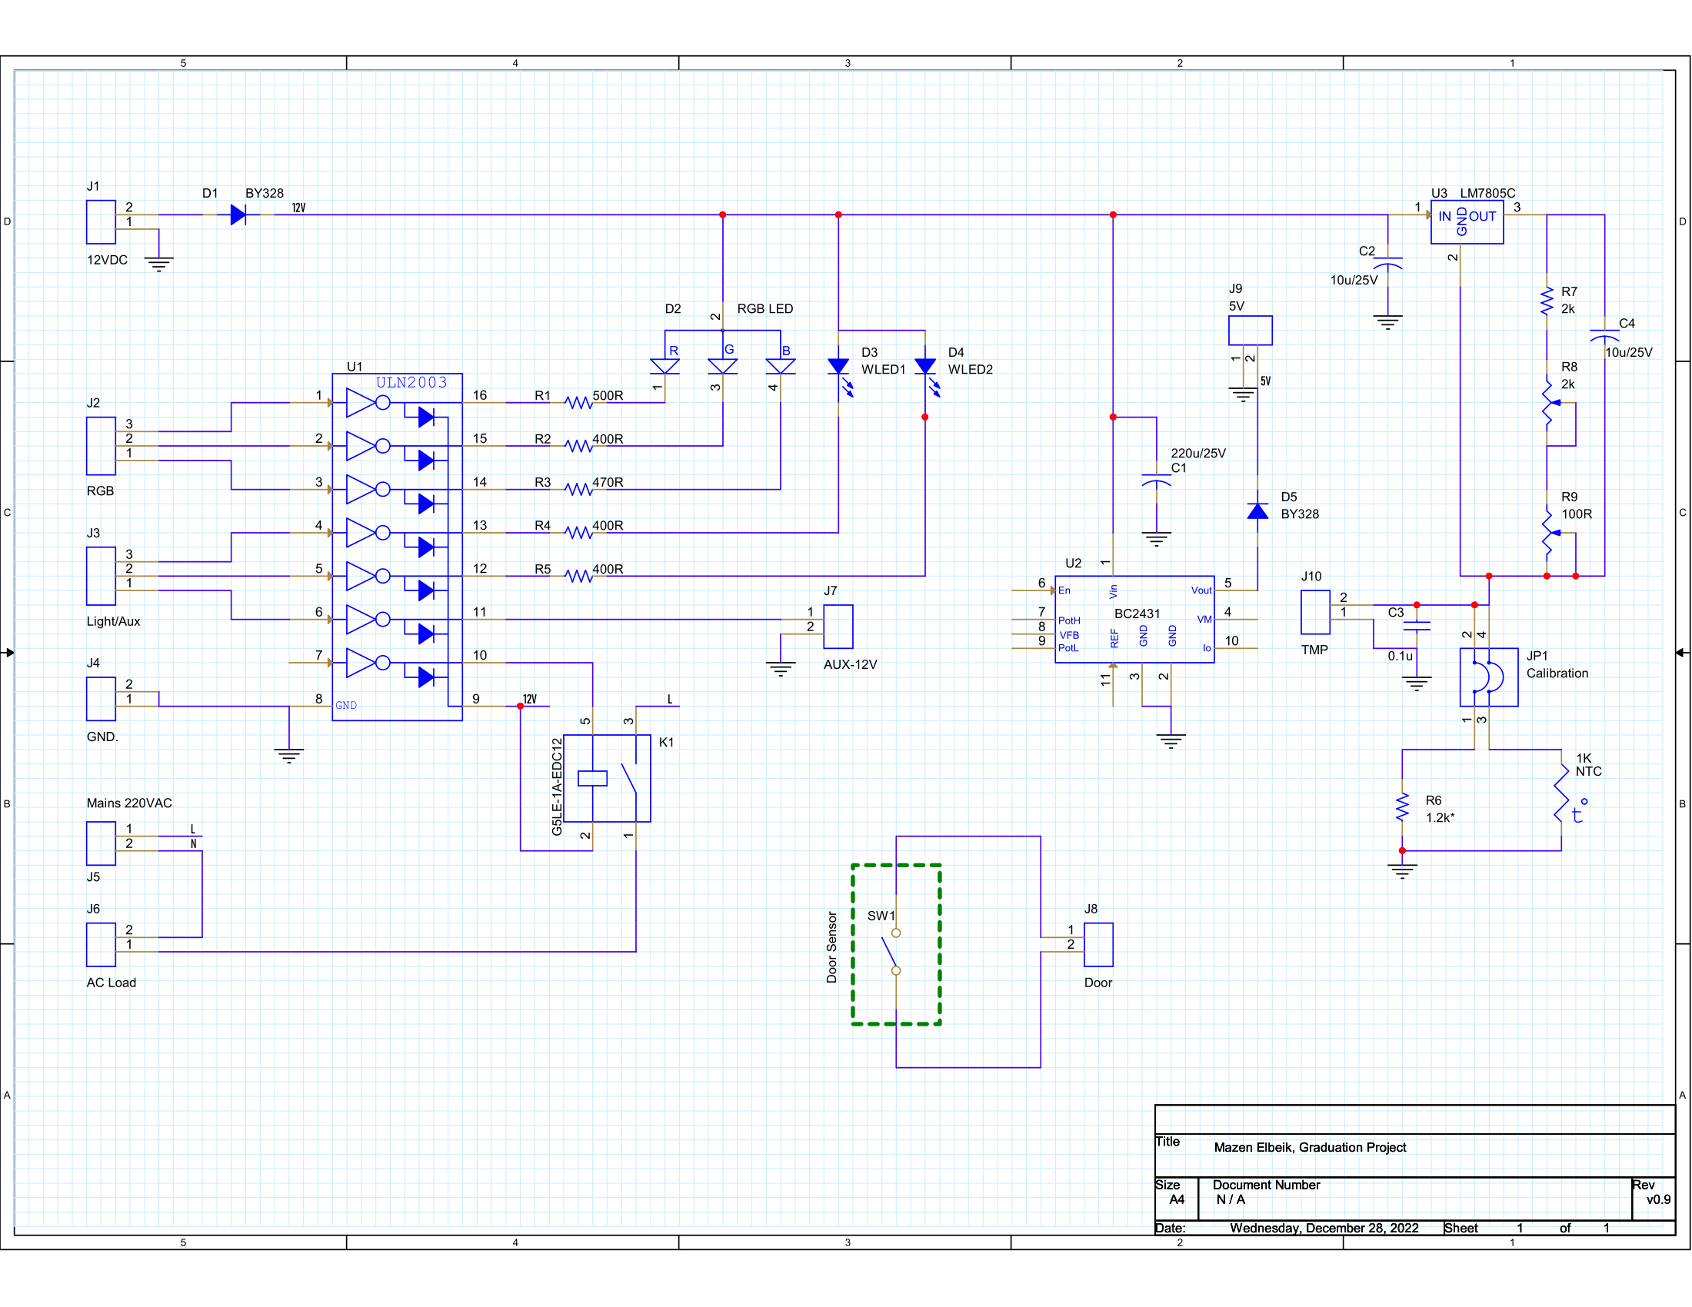
Design

Slide 14
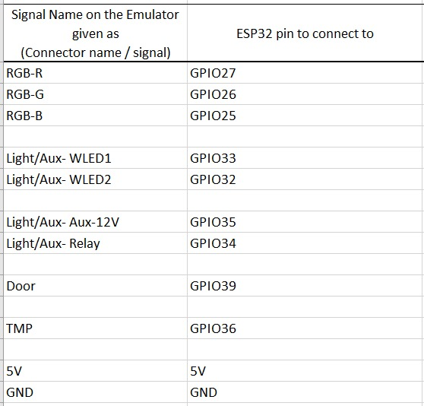
Design

Slide 15
Conclusion
Tasks to be finished next semester
Creating the circuit.
Adding functionality to the mobile application.
Connecting the clients, mobile application & circuit, to the MQTT Broker.
Submitting a fully working model.

